Slide 1

Decent Framework™
Scope the future. Then own it.

Slide 2
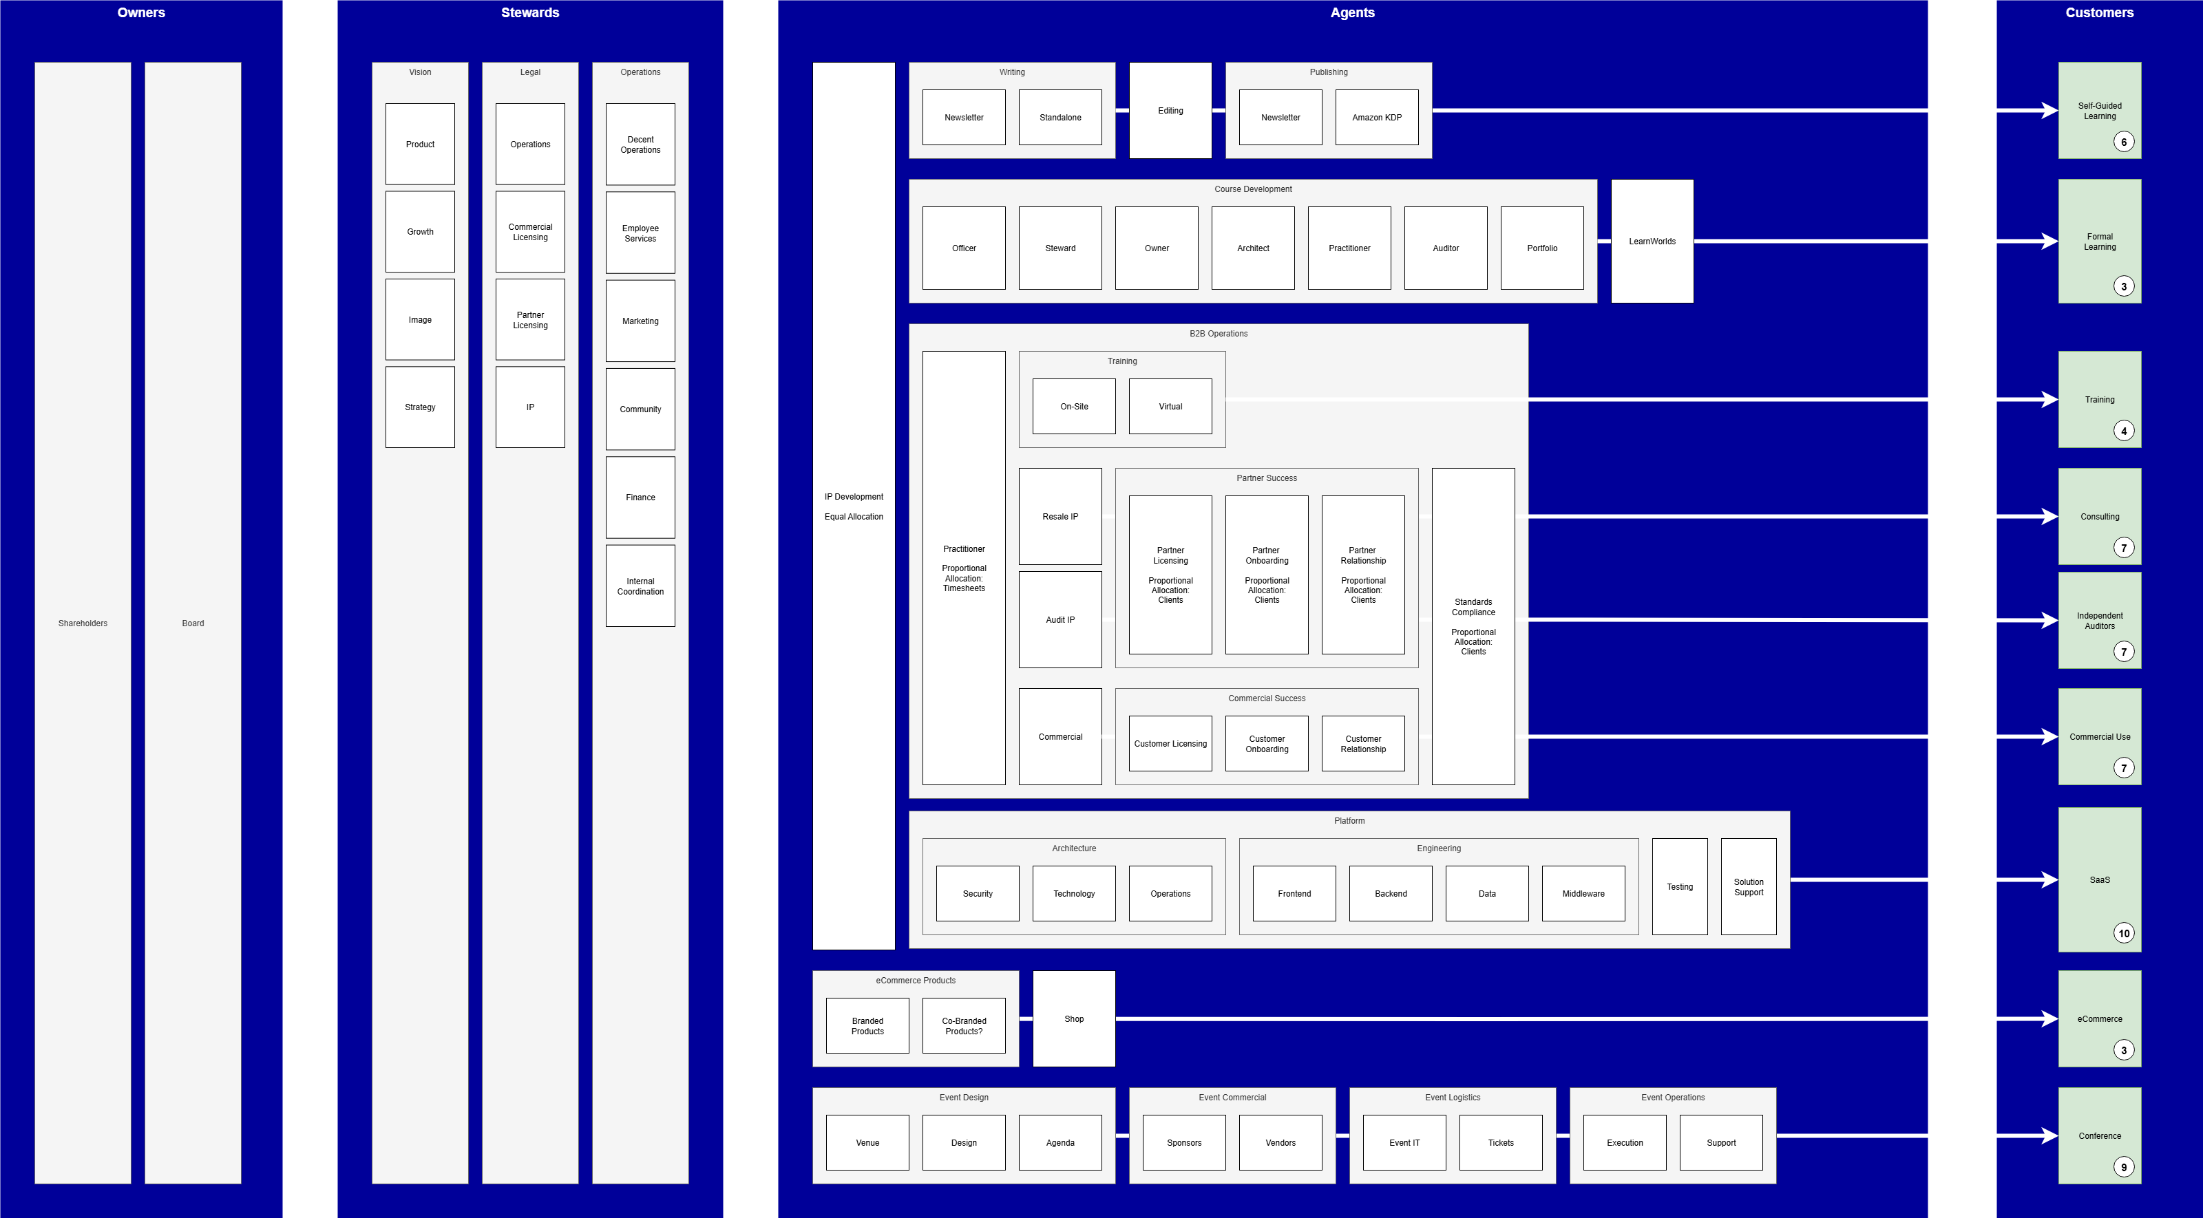
© 2025 Decent Framework, Inc. All rights reserved.

Slide 3

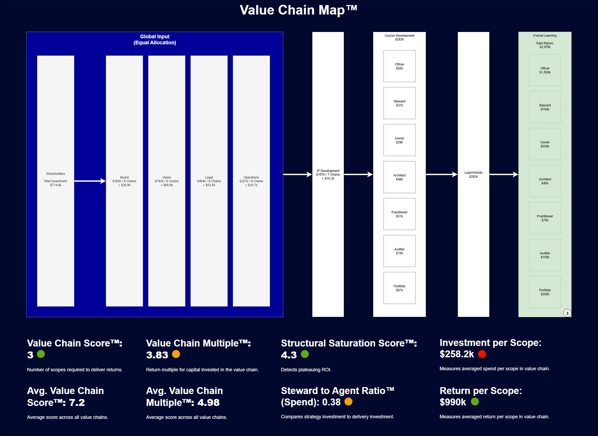
Value-Based Analytics
Capital Allocation
Operational Visibility
ROI
Stagnation Detection
Cross-Chain Analysis
Cross-Company Analysis
Optimization
Growth
Strategy vs. Delivery
Complexity Analysis
© 2025 Decent Framework, Inc. All rights reserved.

Slide 4
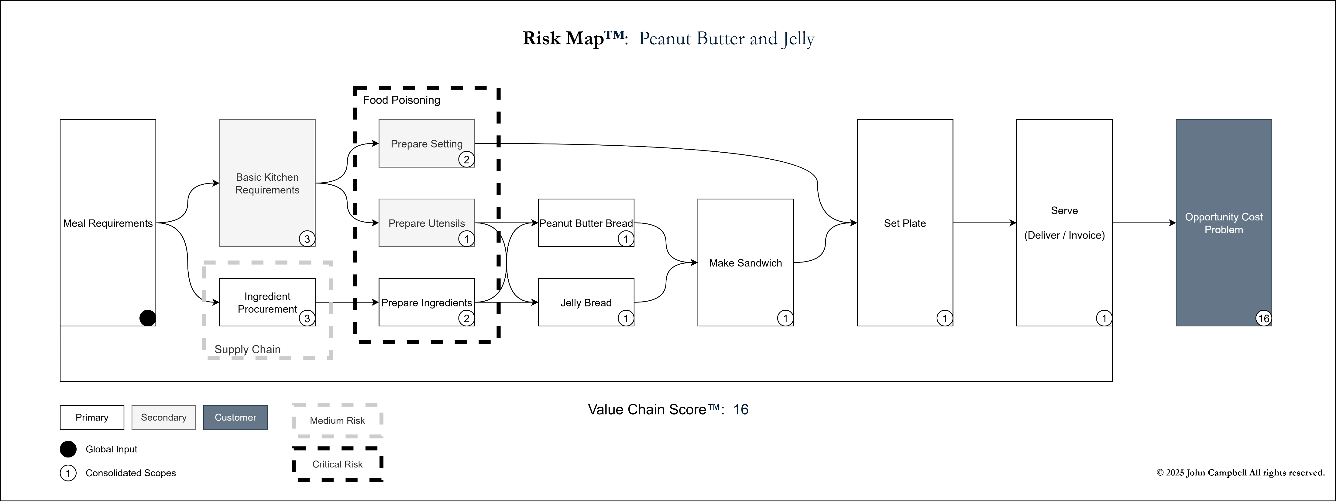
Risk Mapping and Management Value Consolidation and Concentration Ownership and Accountability
© 2025 Decent Framework, Inc. All rights reserved.

Slide 5




Value Discovery (Day 1-30) Free | Value Clarity (Day 30-60) | Value Governance (Day 61-90) | Value Architecture (Day 90-180)
High-Level Activities: Interviews Manager to CXO Org Chart Financials Cost Centers POs Budgets Rollups Processes Approvals Changes Governance Operational Policies Compliance Tech / Security HR Legal Finance Procurement Product SLAs Analyze Artifacts Build Outputs Output: Current State Model Current State Analysis Value Clarity Proposal | High-Level Activities: Define Value Governance Strategy PE Team / CEO Owner / Steward Workshop PE / CXO / Policy Makers Informal Scope Definitions Domain / Output SLAs Success Metric Performance Goals Cost Allocation Metric Owner Inputs Requirements Policies Limitations Budget Operational Risks Leader Information Session Baseline Model Fill Investments Fill Returns Update Owners Add Risks Build Outputs Output: Enhanced Current State Model Value Governance Plan | High-Level Activities: Implement Value Governance Strategy PE Team / CEO / Value Exec Value Governance Training Value Executive (2x Weekly) Formalize Value Charters™ Value-Based Analysis Workshop PE Team / CEO / Value Exec Value Architecture Workshop Value Executive Initial Reviews w/ Value Exec Scope Risk Analysis Identify Model Updates Value Exec Plan Model Changes Value Exec Build Outputs Output: Target State Plan Value Architecture Plan | High-Level Activities: Complete / Tune Value Charters™ Value Exec Close Pending Governance Gaps Investments (Spend) Returns (Revenue) Execute Planned Model Changes Value Exec Initial Baseline Reporting PE Team / CEO / Value Exec Establish Innovation Panel CXO Establish Value Review Process Value Exec Tune Outstanding Compliance / Policy / Regulation Requirements CXO Establish Risk Review Process Value Exec Build Outputs Output: Operational Baseline Final Licensing Support Proposal (Optional)
© 2025 Decent Framework, Inc. All rights reserved.

Slide 6
Thank you.
Next Steps:
6-Month Pilot License (Free)
30-Day Value Discovery (Free)
Review Outputs
Review Proposal
Scope the future. Then own it.
© 2025 Decent Framework, Inc. All rights reserved.

